Slide 1
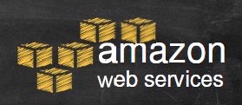

Slide 2

CONTENTS
What is AWS
AWS Global Infrastructure
IAM
VPC
EC2
Autoscaling
Load balancer
Route 53
S3 Bucket
RDS
Cloud front
CloudWatch & Cloud Trail

Slide 3
What is Amazon Web Services ?
Amazon Web Services (AWS) is a collection of remote computing services (web services) that together make up a cloud computing platform, offered over the Internet by Amazon.com.
Website: http://aws.amazon.com
AWS is located in 9 geographical 'Regions‘. Each Region is wholly contained within a single country and all of its data and services stay within the designated Region.
Each Region has multiple 'Availability Zones', which are distinct data centers providing AWS services. Availability Zones are isolated from each other to prevent outages from spreading between Zones. However, Several services operate across Availability Zones (e.g. S3, DynamoDB).

Slide 4

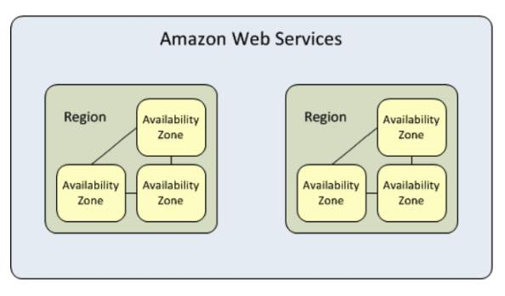
Global Infra structure
AWS is able to support this massive workload thanks to its Global Cloud Infrastructure, which consists of the following:
Availability Zones
Regions
Edge Networks

Slide 5
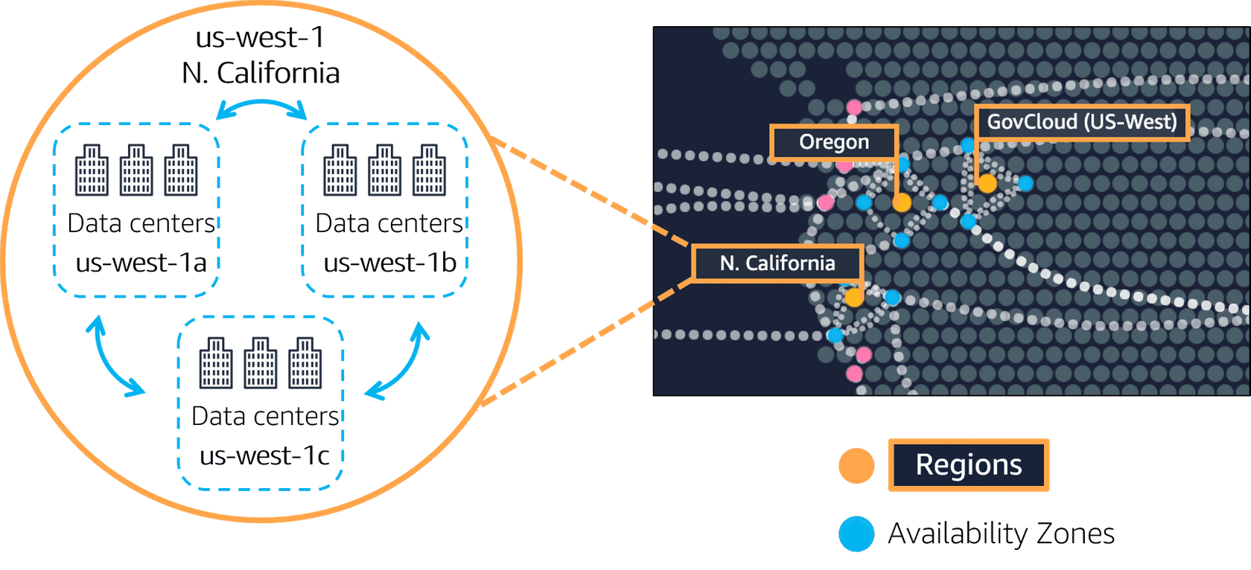
Availability Zones
An Availability Zone consists of one or more data centers, each with redundant power, networking, and connectivity. The data centers of a single Availability Zone, or “AZ” for short, are typically within 100 kilometers or 60 miles of each other.

Slide 6
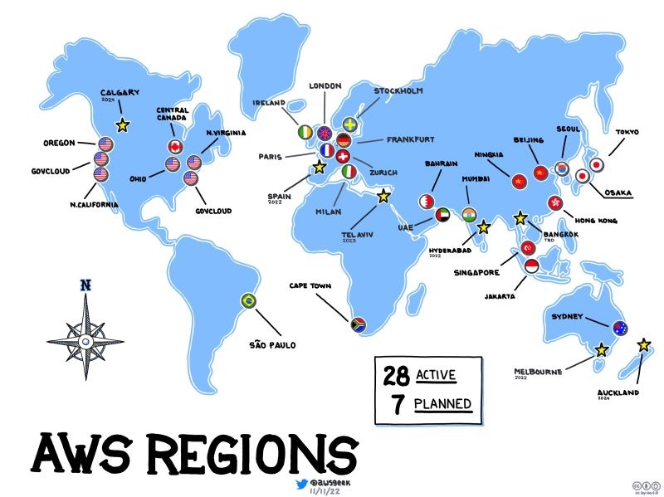
REGIONS
Each AWS Region is a separate geographic area. Each AWS Region has multiple, isolated locations known as Availability Zones.

Slide 7
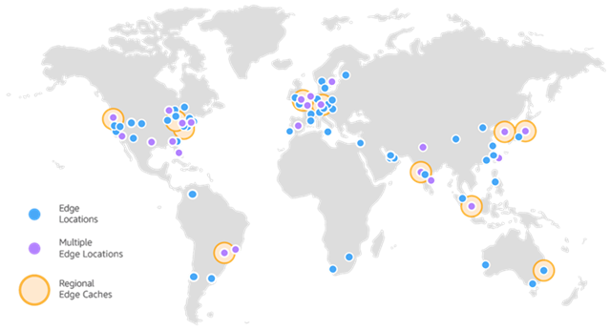
Edge Locations
Edge Location is the Data Center used to deliver content fast to your users. It is the site that is nearest your users.

Slide 8
WHAT IS IAM?
AWS Identity and Access Management (IAM) is a web service that helps you securely control access to AWS resources. With IAM, you can centrally manage permissions that control which AWS resources users can access. You use IAM to control who is authenticated (signed in) and authorized (has permissions) to use resources.

Slide 9

IAM USER
An IAM user is a resource in IAM that has associated credentials and permissions. An IAM user can represent a person or an application that uses its credentials to make AWS requests. This is typically referred to as a service account.

Slide 10
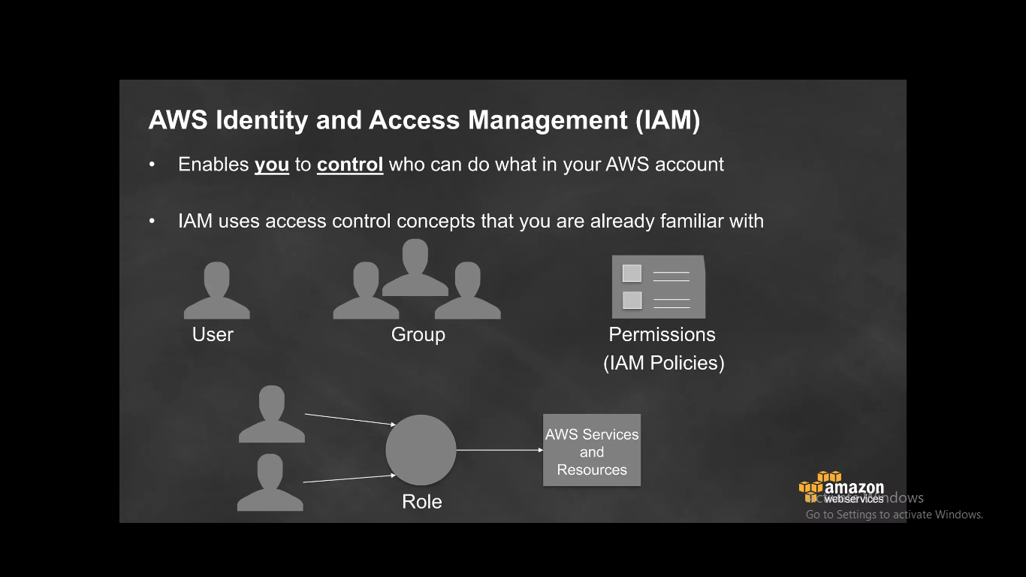

Slide 11
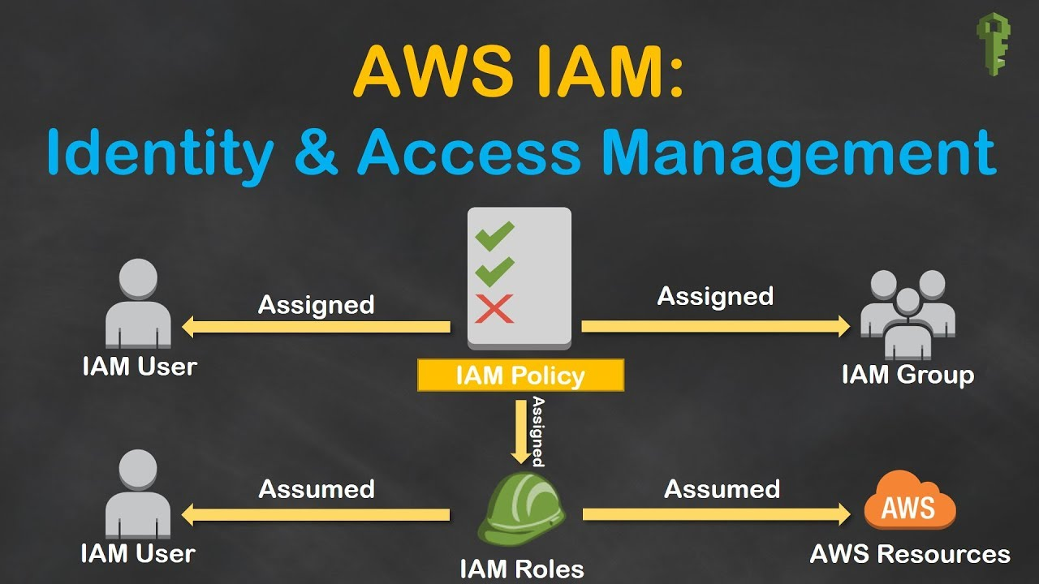

Slide 12
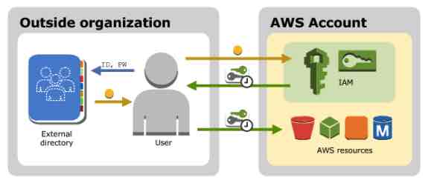
Federated Users
If the users in your organization already have a way to be authenticated, you can federate those user identities into AWS.

Slide 13
When to Create IAM User | When to Create an IAM Role
You created an AWS account and you’re the only person who works in your account. | You’re creating an application that runs on an Amazon EC2 instance and that application makes requests to AWS.
Other people in your group need to work in your AWS account, and your group is using no other identity mechanism. | You’re creating an app that runs on a mobile phone and that makes requests to AWS.
You want to use the command-line interface to work with AWS. | Users in your company are authenticated in your corporate network and want to be able to use AWS without having no sign in again (federate into AWS)

Slide 14
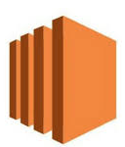
Elastic Compute Cloud (EC2)
A web service that provides resizable compute capacity in the cloud.
EC2 allows creating Virtual Machines (VM) on-demand. Pre-configured templated Amazon Machine Image (AMI) can be used get running immediately. Creating and sharing your own AMI is also possible via the AWS Marketplace.
Pay only for resources actually consume, instance-hours.

Slide 15

EC2 Payment methods
On-Demand Instances let you pay for compute capacity by the hour with no long-term commitments.
Reserved Instances give you the option to make a low, one-time payment for each instance you want to reserve and in turn receive a significant discount on the hourly charge for that instance.
Spot Instances allow customers to bid on unused Amazon EC2 capacity and run those instances for as long as their bid exceeds the current Spot Price.

Slide 16

Elastic Block Store (EBS)
Provides block level storage volumes (1 GB to 1 TB ) for use with Amazon EC2 instances.
EBS volumes are placed in a specific Availability Zone, and can then be attached to instances also in that same Availability Zone.
Each storage volume is automatically replicated within the same Availability Zone.
Features of EBS
Dynamically increase capacity
Tune performance
change the type of live volumes with no downtime

Slide 17

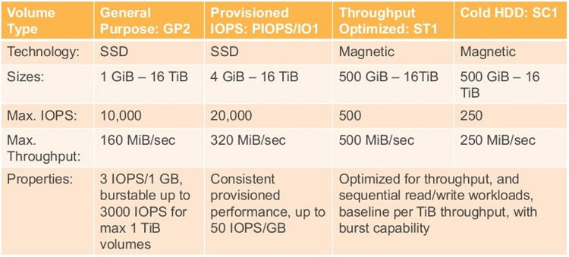
TYPES OF EBS Volumes

Slide 18

AUTO SCALING
AWS Auto Scaling monitors your applications and automatically adjusts capacity to maintain steady, predictable performance at the lowest possible cost. Using AWS Auto Scaling, it's easy to setup application scaling for multiple resources across multiple services at the earliest.
COMPONENTS OF AUTOSCALING
scaling policies
scaling activities
scaling processes

Slide 19
SCALING POLICIES
Manual scaling: In this type of scaling, the number of instances is changed manually. It involves a manual execution of scaling actions.
Scheduled scaling: This type involves the automatic execution of scaling actions based on certain schedules. They can be executed at a specific time during the day, month, week, or year
Dynamic scaling: In dynamic scaling, the number of EC2 instances is changed automatically based on signals that are provided by a CloudWatch alarm.
Predictive scaling
Predictive scaling involves using machine learning algorithms to program the desired number of instances.

Slide 20
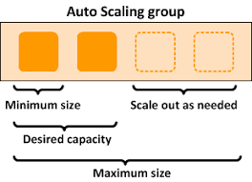

Slide 21

Load Balancing
Distributes incoming application or network traffic across multiple targets, such as EC2 instances, containers (ECS), Lambda functions, and IP addresses, in multiple Availability Zones.
Types of load balancers
EC2 Classic Load Balancer (old version)
Network Load Balancer
Application Load Balancer
Distributes incoming application or network traffic across multiple targets, such as EC2 instances, containers (ECS), Lambda functions, and IP addresses, in multiple Availability Zones.
Types of load balancers
EC2 Classic Load Balancer (old version)
Network Load Balancer
Application Load Balancer
Gate way Road Balancer

Slide 22
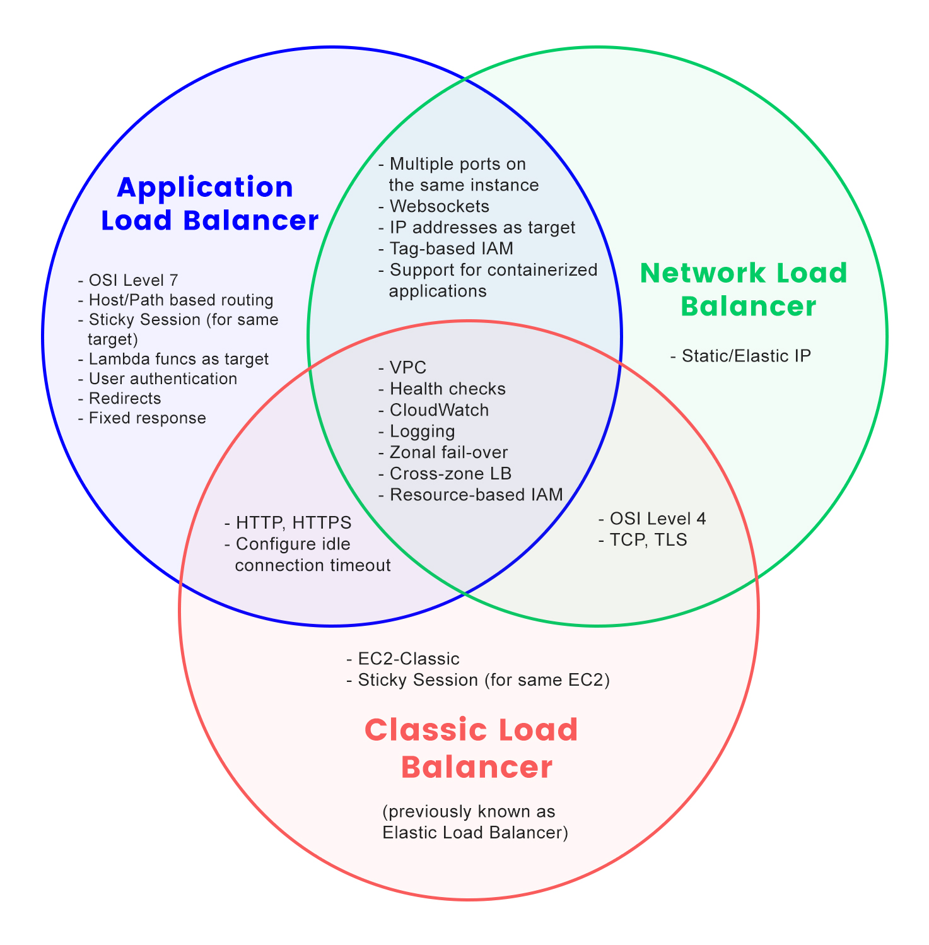

Slide 23

ROUTE 53
Route 53 sends automated requests over the internet to a resource, such as a web server, to verify that it's reachable, available, and functional.
Routing Types:
Simple routing.
Failover routing.
Geolocation routing.
Geo-proximity routing (traffic flow only)
Latency-based routing.
IP-based routing.
Mult-ivalue answer routing.
Weighted routing.

Slide 24
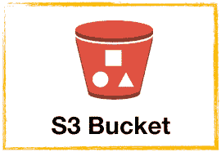
Simple Storage Service (S3)
Amazon S3 provides a simple web services interface that can be used to store and retrieve any amount of data, at any time, from anywhere on the web.
Write, read, and delete objects containing from 1 byte to 5 terabytes of data each. The number of objects you can store is unlimited.
TYPES OF S3 Buckets
S3 Standard
S3 Intelligent Tiering
S3 Standard IA
S3 One Zone IA
S3 Glacier
S3 Glacier Deep Archive

Slide 25
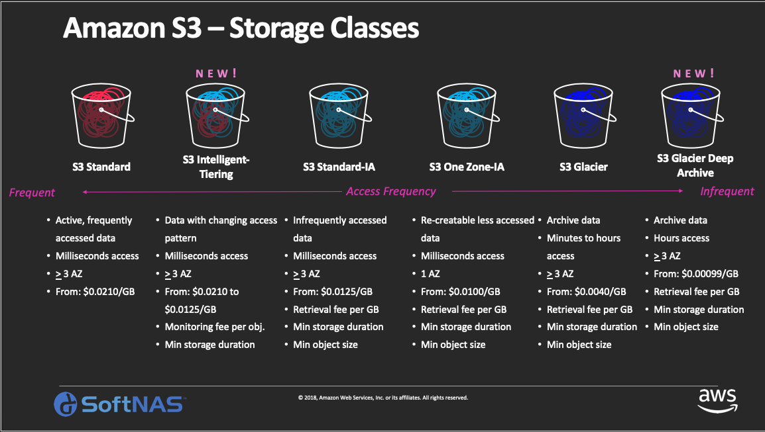
TYPES OF S3 STORAGE

Slide 26

Virtual Private Cloud (VPC)
Amazon VPC lets you provision a logically isolated section of the Amazon Web Services (AWS) Cloud.
Concepts of VPC
Internet Gateway
Public Subnet
Private Gateway
NAT Gateway
Route Table

Slide 27

Amazon Relational Database Service (RDS)
Amazon RDS is a web service that makes it easy to set up, operate, and scale a relational database in the cloud.
Amazon RDS gives access to the capabilities of a familiar MySQL, Oracle or Microsoft SQL Server database engine.
Code, applications, and tools already used with existing databases can be used with RDS.
Amazon RDS automatically patches the database software and backs up the database, storing the backups for a user-defined retention period and enabling point-in-time recovery.
Amazon RDS provides scaling the compute resources or storage capacity associated with the Database Instance.
Pay only for the resources actually consumed, based on the DB Instance hours consumed, database storage, backup storage, and data transfer.
On-Demand DB Instances let you pay for compute capacity by the hour with no long-term commitments.
Reserved DB Instances give the option to make a low, one-time payment for each DB Instance and in turn receive a significant discount on the hourly usage charge for that DB Instance.

Slide 28

Amazon Dynamo DB
Dynamo DB is a fast, fully managed NoSQL database service that makes it simple and cost-effective to store and retrieve any amount of data, and serve any level of request traffic.
All data items are stored on Solid State Drives (SSDs), and are replicated across 3 Availability Zones for high availability and durability.
Dynamo DB tables do not have fixed schemas, and each item may have a different number of attributes.
Dynamo DB has no upfront costs and implements a pay as you go plan as a. a flat hourly rate based on the capacity reserved.

Slide 29

CLOUD FRONT
Amazon CloudFront is a content delivery network (CDN) service that helps you distribute your static and dynamic content quickly and reliably with high speed
The two main components of AWS Cloud front are
content delivery
dynamic content caching.

Slide 30

Amazon Cloud Watch
Amazon Cloud Watch provides monitoring for AWS cloud resources and the applications customers run on AWS.
Amazon Cloud Watch enables you to monitor your AWS resources up-to-the-minute in real-time, including:
Amazon EC2 instances,
Amazon EBS volumes,
Elastic Load Balancers,
Amazon RDS DB instances.
Metrics such as CPU utilization, latency, and request counts are provided automatically for these AWS resources.
Customers can also supply their own custom application and system metrics, such as memory usage, transaction volumes, or error rates,.

Slide 31
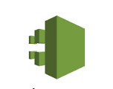
Cloud Trail
Amazon CloudTrail is a service that enables governance, compliance, operational auditing, and risk auditing of your Amazon Web Services account. With CloudTrail, you can log, continuously monitor, and retain account activity related to actions across your Amazon Web Services infrastructure. CloudTrail provides event history of your Amazon Web Services account activity, including actions taken through the Amazon Management Console, Amazon SDKs, command line tools, and other Amazon Web Services . `

Slide 32
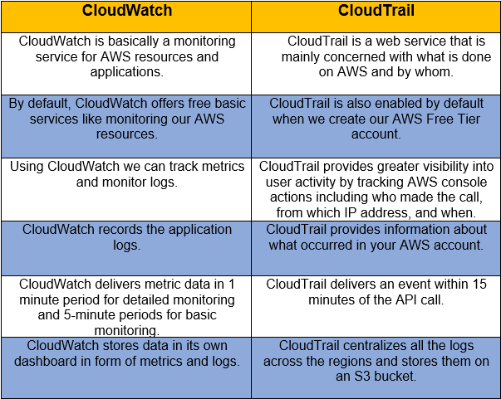

Slide 33



